Slide 1

Email marketing report

Slide 2
Overall marketing goal
Our goal is to increase summer season ticket sales by 10% over last year’s numbers through a combination of targeted paid, social, and email marketing campaigns.

Slide 3
Email marketing goal
To support the overall goal of selling more tickets, we want to raise open rates and click-to-open rates for campaign emails.
We want to know:
What types of emails have performed the best with different subscriber segments in the past?
What types of email content should we prioritize for each segment in our new campaign?

Slide 4
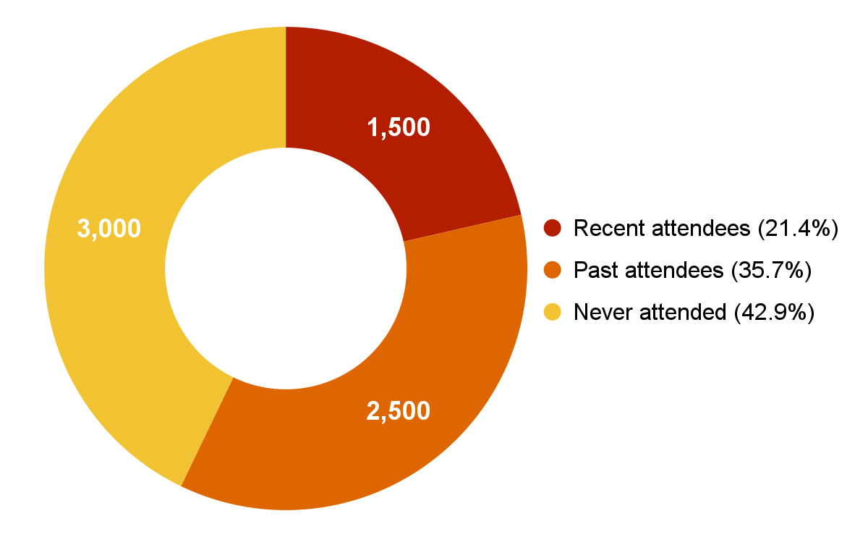
Email subscriber segments
Notes:
Summary: We want to increase engagement with campaign emails across all segments because recent attendees make up only about one fifth of our subscriber list. Past attendees and subscribers who have never attended a performance make up over three quarters of our email list. In order to reach our overall goal of a 10% increase in attendance, we need to engage these segments more effectively.

Slide 5
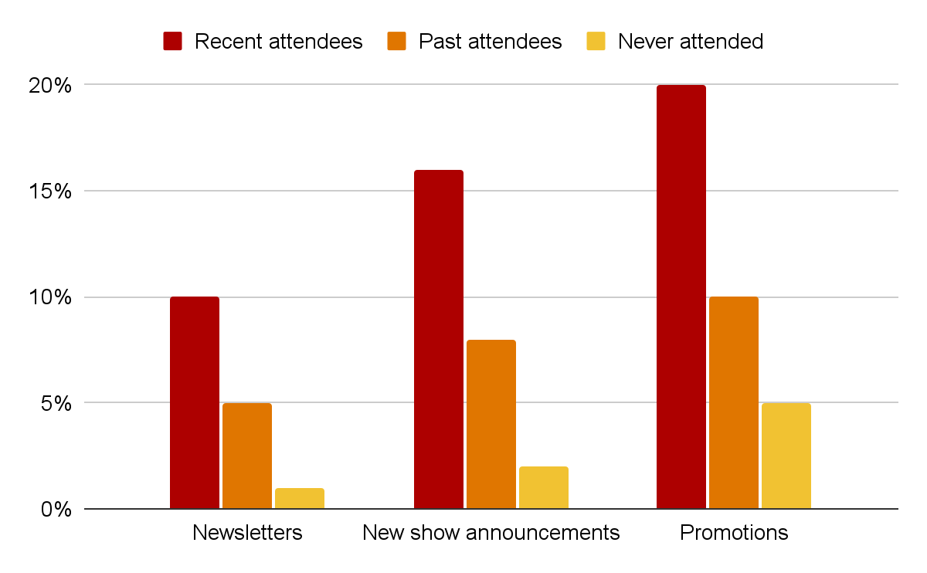
Open rates by email category
Notes:
Summary: Recent attendees are the ones who opens our emails the most. Promotions has the best open rate. If we want to increase our summer season sales we need to use more promotions and engage past attendees and never attended groups.

Slide 6
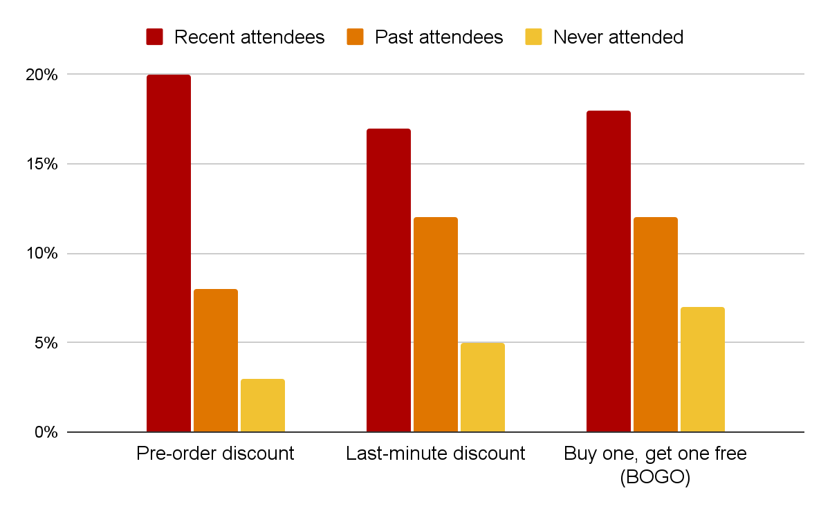
Open rates by promotion type
Notes:
Summary: The best promotion type for never attended open rates is the BOGO. Last-minute discount and BOGO are the best for past attendees. Pre-order discount performs the best with recent attendees. We can segment our email into groups to give each group type the most suitable promotion type.

Slide 7
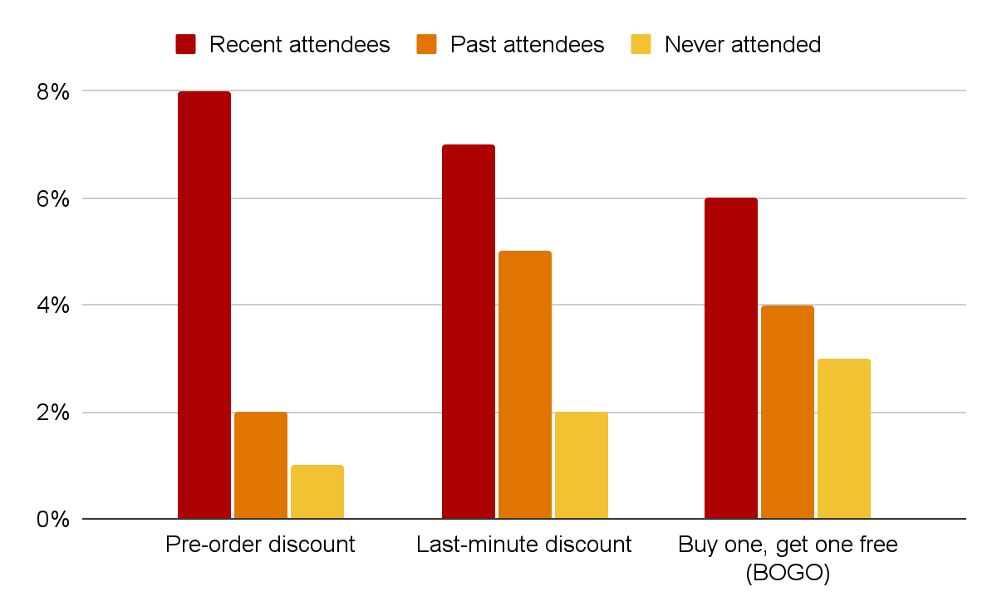
Click-to-open rates by promotion type
Notes:
Summary: Recent attendees prefer pre-order discount as a promotion as they are more likely to click on this kind of promotion type. Past attendees prefers last-minute discount as they are more likely click using this type of promotion. Never attended clicks more likely on BOGO promotion type. If we are trying to increase sale then we have to use the promotion type with the highest click-to-open rates for each group type.

Slide 8
Conclusion and recommendations
Recent attendees: Send Pre-order discount promotional emails
Past attendees: Send Last-minute discount promotional emails
Never attended: Send Buy one, get one free promotional emails

